Slide 1
Vision for SchwarzShuttle Data Platform

Slide 2
Agenda
1
Vision for SchwarzShuttle Data Platform
2
Proposed Architecture
3
Functional Requirements
4
Non-Functional Requirements
5
Automation
6
DevOps/DevSecOps Diagram
7
Workflow
8
Tools and Processes for Data Security
9
Vision for the Future
10
Key Focus Areas (Next 2-3 Years)
11
Conclusion
12
Q&A

Slide 3




Vision for SchwarzShuttle Data Platform
Building a Secure, Scalable, and Future-Ready Taxi Business
Vision Statement
Our aim is to revolutionize urban transport through advanced data platforms that leverage emerging technologies.
Future-Ready Infrastructure
The platform will be designed to seamlessly integrate innovative technologies, ensuring adaptability for future advancements.
Secure Framework
Implementing robust security measures to safeguard user data and ensure compliance with regulatory standards.
Scalability
Designing an architecture capable of easily managing increased user demand, ensuring seamless operations during peak times.

Slide 4
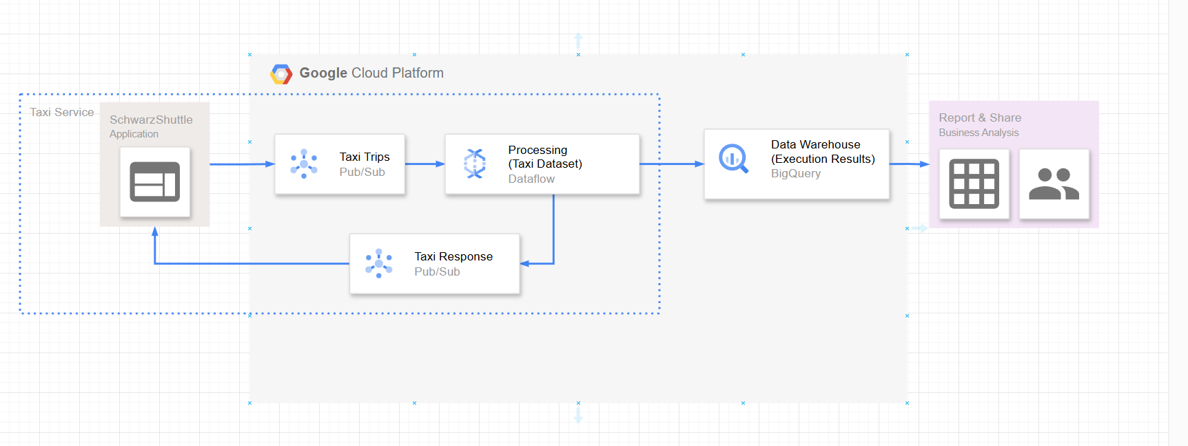
Proposed Architecture
A real-time, integrated, scalable, and secure foundation for a new taxi app

Slide 5




Functional Requirements
Real-time taxi tracking and dispatching
The platform will feature GPS-enabled real-time tracking for enhanced user and driver visibility, improving overall service reliability.
Customer booking and payment processing
A streamlined, user-friendly booking interface that facilitates quick reservations, with integrated payment options for customer convenience.
Driver management and analytics
Tools for managing driver profiles, performance analytics, and training modules, ensuring high service quality and compliance.
Business intelligence and reporting
Incorporating analytical capabilities that generate insights from data to drive strategic business decisions and operational improvements.

Slide 6
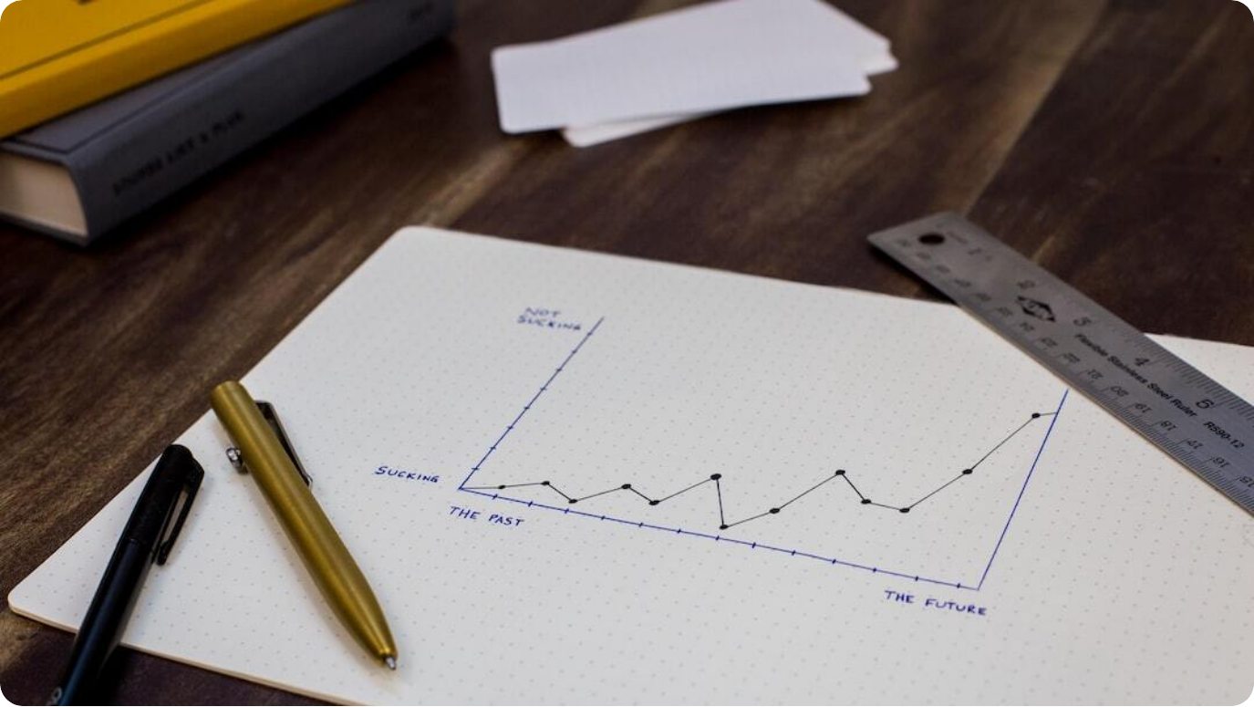
Non-Functional Requirements
High Availability: Achieving a 99.9% uptime, ensuring that the service is always operational and accessible for users and drivers at all times.
Reliability Metrics: Implementing failover strategies and consistent monitoring to minimize service disruptions, thereby enhancing user trust and satisfaction.
Scalable Solutions: Capacity to dynamically manage increased workloads with minimal impact on responsiveness or performance during peak times.
Data Security Standards: Adhering to top-tier security protocols to protect sensitive information and maintain user trust within the platform.
Photo by Isaac Smith on Unsplash

Slide 7




DevOps Automation
Code
Automated Deployments
Faster feature rollouts with minimal errors
Scaling Automation
Adjusts resources dynamically for optimal performance
Monitoring Systems
Real-time anomaly detection and resolution
CI/CD Pipeline
Seamless code-to-deployment process
Build
Test
Deploy

Slide 8
DevSecOps Processes
Tools and Processes for Data Security
Tools:
Encryption: Key Management Service (KMS)
Access Control: IAM
Monitoring: Cloud Logging
Data Loss Prevention: DLP API
Processes:
Regular security audits
Incident response plans
Compliance checks (e.g., GDPR)

Slide 9
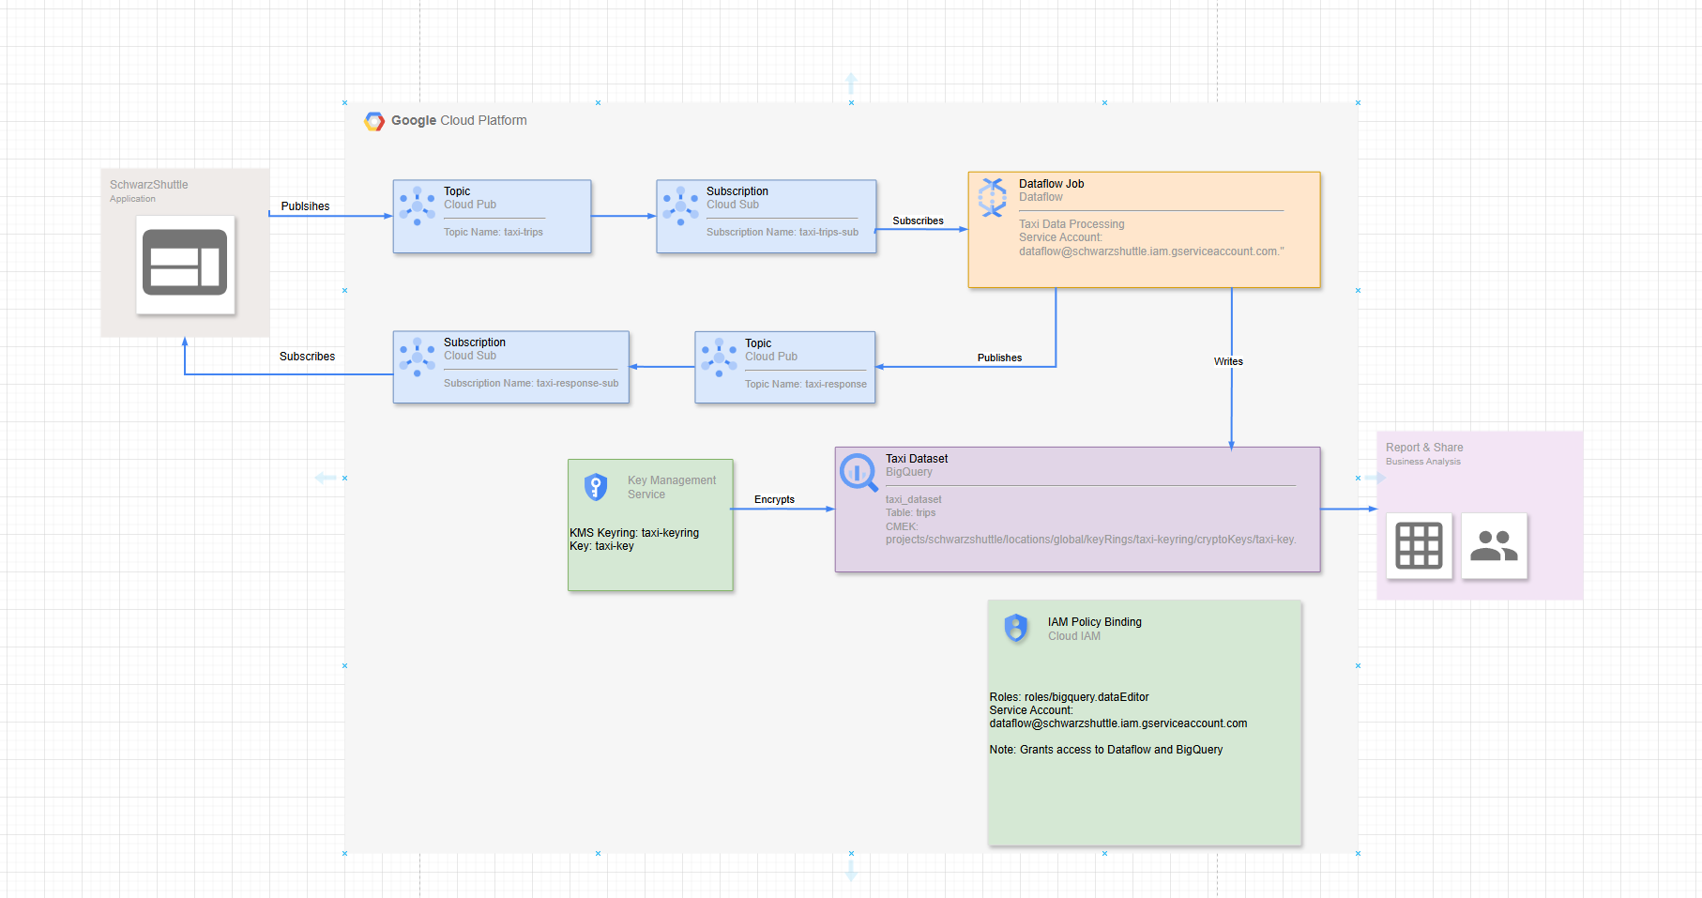
Low-Level Workflow

Slide 10




Vision for the Future
AI-Driven Dispatching
Integrating AI technologies to enhance dispatch efficiency, optimize routes, and improve user experience through predictive analytics.
Customer-Centric Approach
Leveraging technology to create personalized experiences based on user preferences and past interactions for enhanced satisfaction.
Autonomous Vehicle Integration
Setting the stage for seamless integration of autonomous vehicles into the fleet, exploring future mobility solutions.
Sustainability Analytics
Utilizing analytical tools to evaluate and enhance sustainability efforts within the business strategy and operational practices.

Slide 11
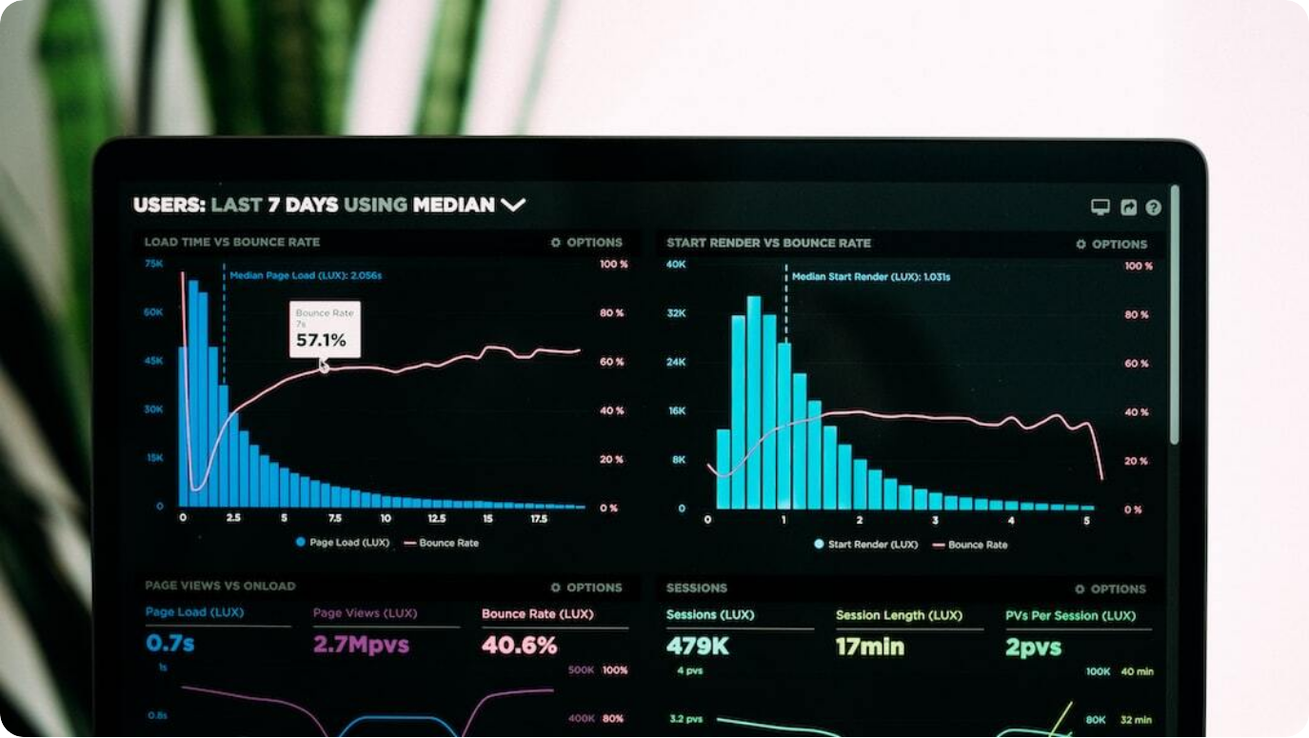
Key Focus Areas (Next 2-3 Years)
Real-time Capabilites
Security and compliance
AI and machine learning adoption
Scalability and flexibility
Photo by Luke Chesser on Unsplash

Slide 12

Conclusion
Foundation for Innovation: Our platform is structured to be both secure and scalable, laying the groundwork for continuous innovation.
Photo by Alexander Redl on Unsplash

Slide 13
Q&A
Open Floor: Inviting questions from the audience,

